Slide 1








Social Media Analytics Bi-partite Networks RoI of Social Media Spend MSBA, Spring 2019, Feb 18 (Session 4)
Dr. Anitesh Barua
David Bruton Jr. Centennial Chair Professor of Business
Distinguished Fellow, INFORMS Information Systems Society
Stevens Piper Foundation Professor
University of Texas Distinguished Teaching Professor
Associate Director, Center for Research in e-Commerce
McCombs School of Business, University of Texas at Austin
Email: aniteshb@gmail.com

Slide 2
Types of Networks
Uni-partite, bi-partite, tri-partite (or multi-partite) networks
Also called 1-mode, 2-mode, etc.
Uni-partite: Only one type of nodes (e.g., people)
Bi-partite: E.g., authors & articles, actors & movies, FB users and their group memberships, etc.

Slide 3
Bi-partite Networks: An Example
1
2
3
4
Authors
A
B
C
Articles
No connections between nodes of the same type
Can we reduce this network to 1-mode? How?

Slide 4
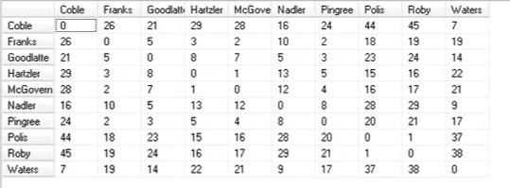
2-mode to 1-mode Networks
2-mode: Congress(wo)man & age
How to reduce to 1-mode?
Source: http://www.umasocialmedia.com/socialnetworks/networks-lecture-13-qap-correlation/

Slide 5
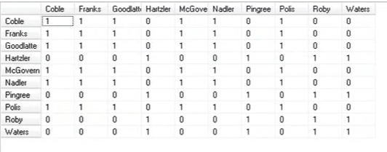
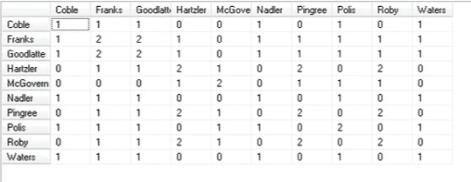
Gender & Committees
Source: http://www.umasocialmedia.com/socialnetworks/networks-lecture-13-qap-correlation/

Slide 6
What are the Correlations Among These Networks?
Can we use Pearson correlation?
Any issues or problems?
Quadratic Assignment Procedure (QAP) correlations
Calculates Pearson correlations between pairs of matrices
Randomly & repeatedly permutes rows and columns of one matrix to compute whether or not the correlations from random assignment are ≤ observed correlations
QAP p-value: Proportion of random correlations ≥ observed correlation

Slide 7
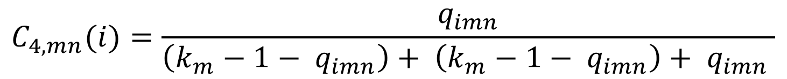
Clustering Coefficient for Bi-partite Networks
i
m
n
d
c
a
b
For 1-mode networks, clustering coefficient of a node =
# Δ formed by the node and pairs of its neighbors / # such Δ possible
But what about bi-partite (2-mode) networks?
Let node i have two neighbors, m and n
Let q_{imn} be the number of “squares” that include i, m and n.
Let k_{m} and k_{n} be the degree of nodes m and n respectively.
Bi-partite clustering coefficient for i & a pair of its neighbors, m & n
$$C_{4,mn}(i)=\frac{q_{imn}}{\left(k_{m}−1− q_{imn}\right)+ \left(k_{m}−1− q_{imn}\right)+ q_{imn} }$$
Source: P. Zhang et al. 2013

Slide 8
How to Detect Communities Within Networks
Why do businesses care about community detection?
Common for uni-partite (1-mode) networks
Girvan-Newman algorithm (divisive algorithm)
Calculate betweenness centrality of “links”
How?
Start cutting out links with highest link centrality until the network disintegrates into disjoint parts
What can we do for bi-partite networks?

Slide 9
Communities in Bi-partite Networks
Densely linked parts of a bi-partite network
constitute communities
E.g., people’s memberships in a set of activities
Concerts
Music lessons
Woodworking
Painting
Notes:
Dotted lines are weak links
We haven’t answered what binds these groups together
If all the squares that can be formed are already formed, it means all the communities that can be formed are already formed
Network better across programs

Slide 10
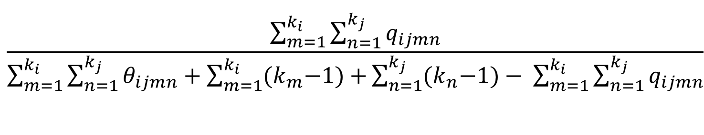
Detecting Communities in Bi-partite Networks
r
i
k_{m} & k_{n} degrees of m & n
q
m
p
n
j
For a pair of nodes, i and j, let m and n be neighbors of i and j respectively
q_{ijmn} = 1 if m and n are connected, 0 otherwise. θ_{ijmn} has the opposite definition.
Edge clustering coefficient C(i, j) =
# squares that currently include i-j / possible # squares that include i-j
$$\frac{\sum_{m=1}^{k_{i}}{\sum_{n=1}^{k_{j}}{q_{ijmn}}}}{\sum_{m=1}^{k_{i}}{\sum_{n=1}^{k_{j}}{θ_{ijmn}}}+\sum_{m=1}^{k_{i}}{{(k}_{m}−1)+}\sum_{n=1}^{k_{j}}{{(k}_{n}−1)− \sum_{m=1}^{k_{i}}{\sum_{n=1}^{k_{j}}{q_{ijmn}}}}}$$
Source: P. Zhang et al. 2013
Notes:
I’s neighbor is an activity, m’s neighbor is a person
Possibilities where the two neighbors aren’t connected
Q(ijmn) = 2
Here we start with the lowest, as compared to the other one where we start with the highest

Slide 11

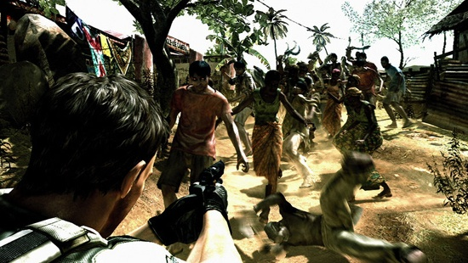
Where is the Return on Influence (ROI) from Social Media Spend?
Can social or digital Word-of-Mouth (WOM) ROA be higher than that of paid search?
What kind of incentives are required for spreading the word in social networks?
How can we measure social ROA?
Copyright Anitesh Barua 2019
Notes:
CAPCOM used social media marketing using word of mouth to understand how powerful it needs to be
Meteor solutions – created a simple javascript rule to track shares by appending ID at the end of the link
They could identify what was direct traffic and what was word of mouth

Slide 12
Direct Vs. WOM Traffic
Rank by Direct Traffic | Site | Direct Referrals
1 | CAMPAIGN SITE | 14,467
2 | ad.adlegend.com (AD SERVER) | 12,850
3 | g.doubleclick.net (AD SERVER) | 8,611
4 | www.jeuxvideo.com | 7,844
5 | www.youtube.com | 5,412
6 | FAN SITE | 4,455
7 | forums.gametrailers.com | 3,678
8 | es.wikipedia.org | 3,630
9 | FAN SITE | 3,494
10 | www.pornbb.org | 2,251
11 | www.meristation.com | 2,247
12 | answers.yahoo.com | 2,064
13 | mail.live.com | 1,985
14 | www.giga.de | 1,906
15 | COMPANY SITE | 1,650
16 | www2.hshare.net | 1,531
17 | www.spaziogames.it | 1,481
18 | www.akiba-online.com | 1,477
19 | www.joystiq.com | 1,097
20 | www.neogaf.com | 1,045
21 | FAN SITE | 1,026
22 | www.xbox360achievements.org | 725
23 | CAMPAIGN SITE | 291
24 | es.youtube.com | 72
25 | www.jeuxactu.com | 61
The common view of traffic sources

Slide 13
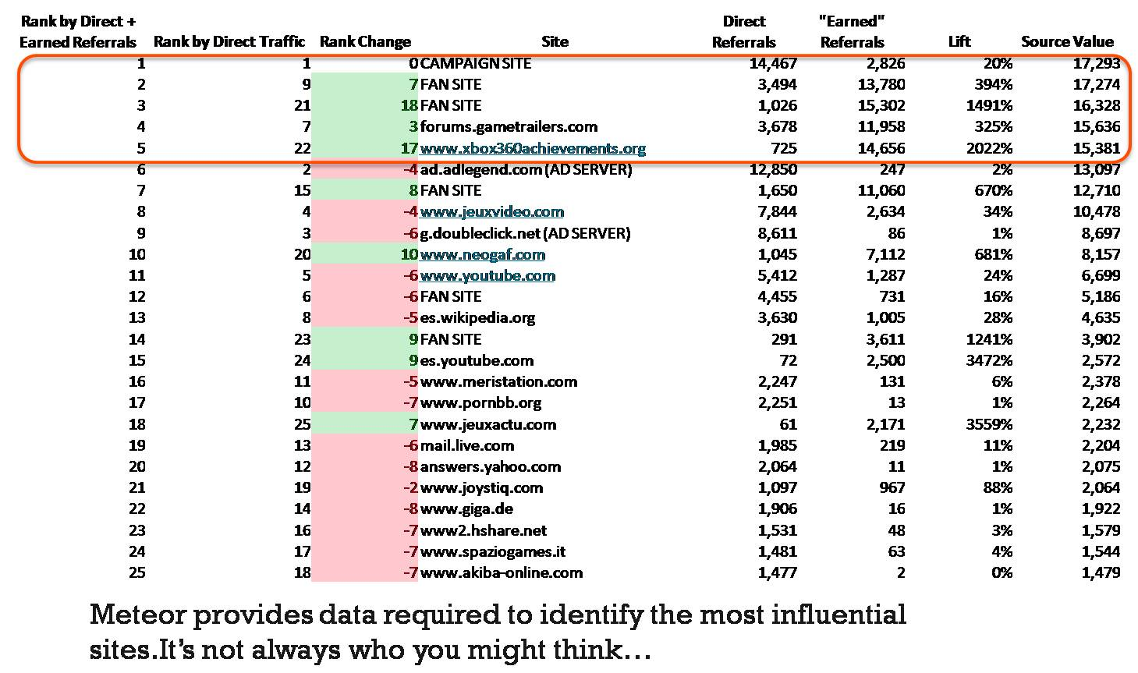
WOM (Social) Referrals
Rank
Direct + WOM traffic
Rank
Direct traffic
SITE
Direct traffic
WOM traffic
LIFT: WOM/Direct
Notes:
Campaign site is direct
Top 5 sites are free, cost POV they drive higher traffic and are better

Slide 14
“If You Got the Money Honey I Got the Time”
 |  | Marketing Tactic
Traffic | Metric | Paid search | Organic search | Display ads | Email | Total
Direct | Total cost | $9,342 | $3,000 | $10,428 | $2,000 | $24,770
 | Customer value | $50 | $50 | $50 | $50 | $50
 | Direct visits | 12,039 | 23,637 | 9,472 | 1,294 | 34,532
 | Conversions | 473 | 1,064 | 313 | 83 | 1933
 | Conversion rate | 0.039 | 0.045 | 0.033 | 0.064 | 0.056
 | Direct profit | $14,308 | $50,200 | $5,222 | $2,150 | $71,880
WOM | WOM Visits | 1960 | 7879 | 937 | 609 | 11385
 | Conversions | 136 | 697 | 93 | 110 | 1036
 | Conversion rate | 0.069 | 0.088 | 0.099 | 0.181 | 0.091
 | WOM profit | $6,800 | $34,850 | $4,650 | $5,500 | $51,800
 | Profit lift = WOM $ / Direct $ | 0.4752586 | 0.694223108 | 0.89046 | 2.5581 | 0.72065
Notes:
$9342 spent for 12K clicks, $0.75 per click
Expedia conversion rate is 0.2%. Kayak is almost 5% since it shows all the options

